Slide 1
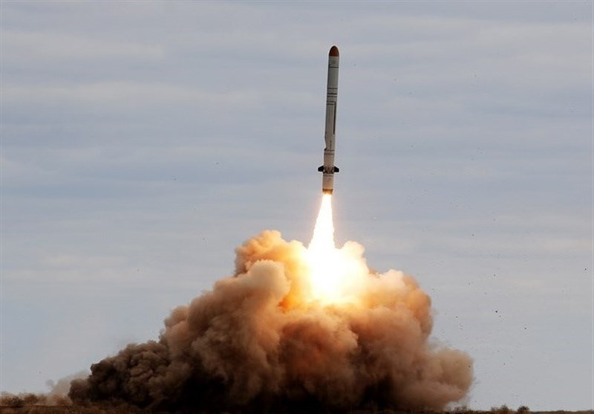
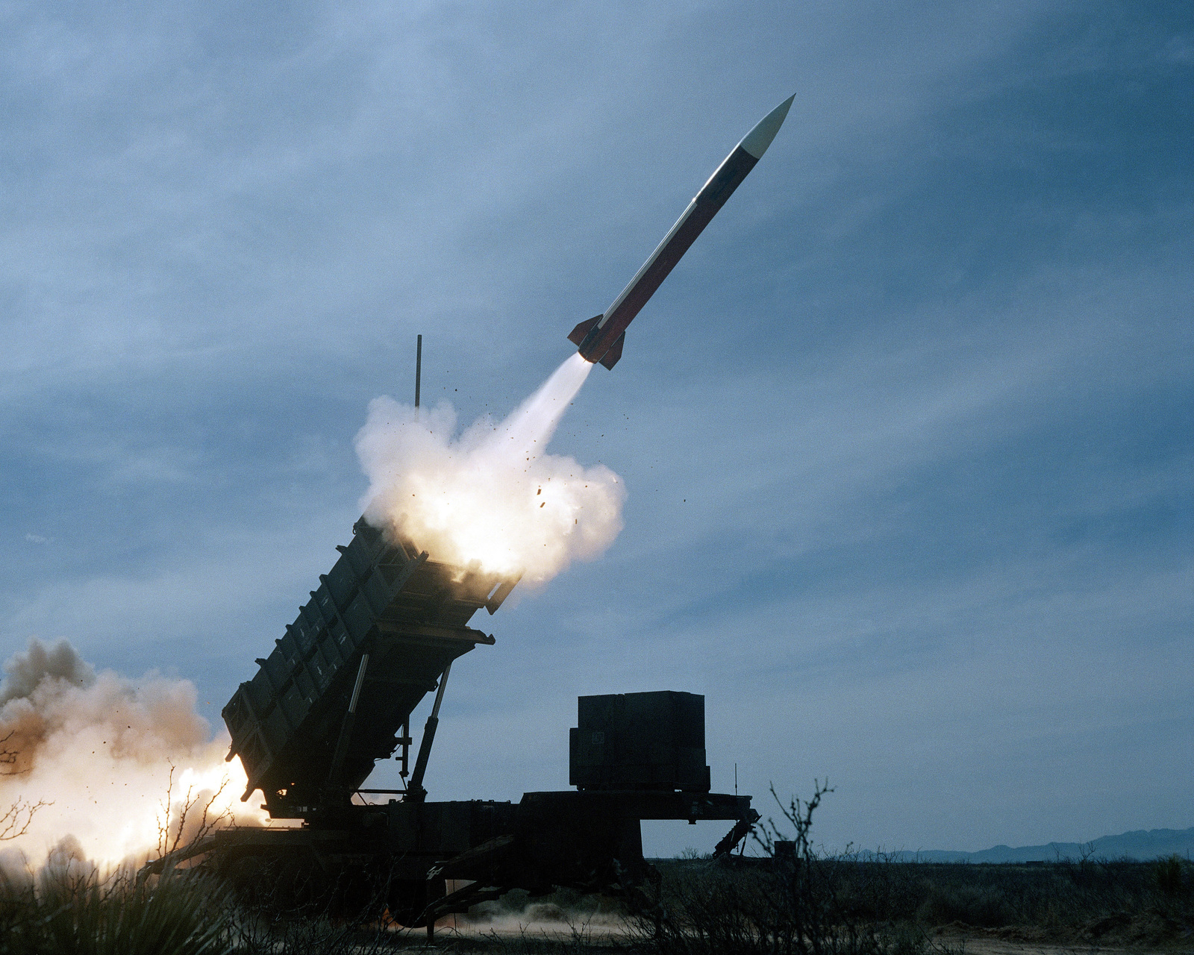
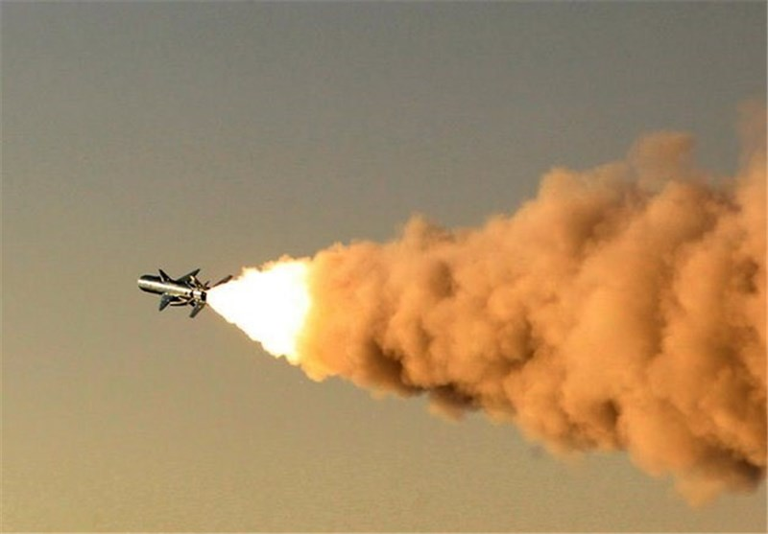
Self-Guided missile
(Liquid Nitrogen Propulsion system)
This Photo by Unknown Author is licensed under CC BY
This Photo by Unknown Author is licensed under CC BY

Slide 2
Content
Introduction
Summary
Aerodynamics of missile
Inertial Navigation System
RL for Missile guidance system

Slide 3
Introduction
This scientific description introduces a novel self-guided missile system powered by liquid nitrogen propulsion and equipped with advanced guidance or target tracking capabilities driven by machine learning (ML). This missile utilizes side thrusters that autonomously activate at predetermined locations, facilitated by real-time calculations made by an integrated ML model. Employing a gyroscope for balance, the missile is designed for the precise targeting of moving objects, possessing three degrees of freedom to navigate in all three-dimensional planes

Slide 4
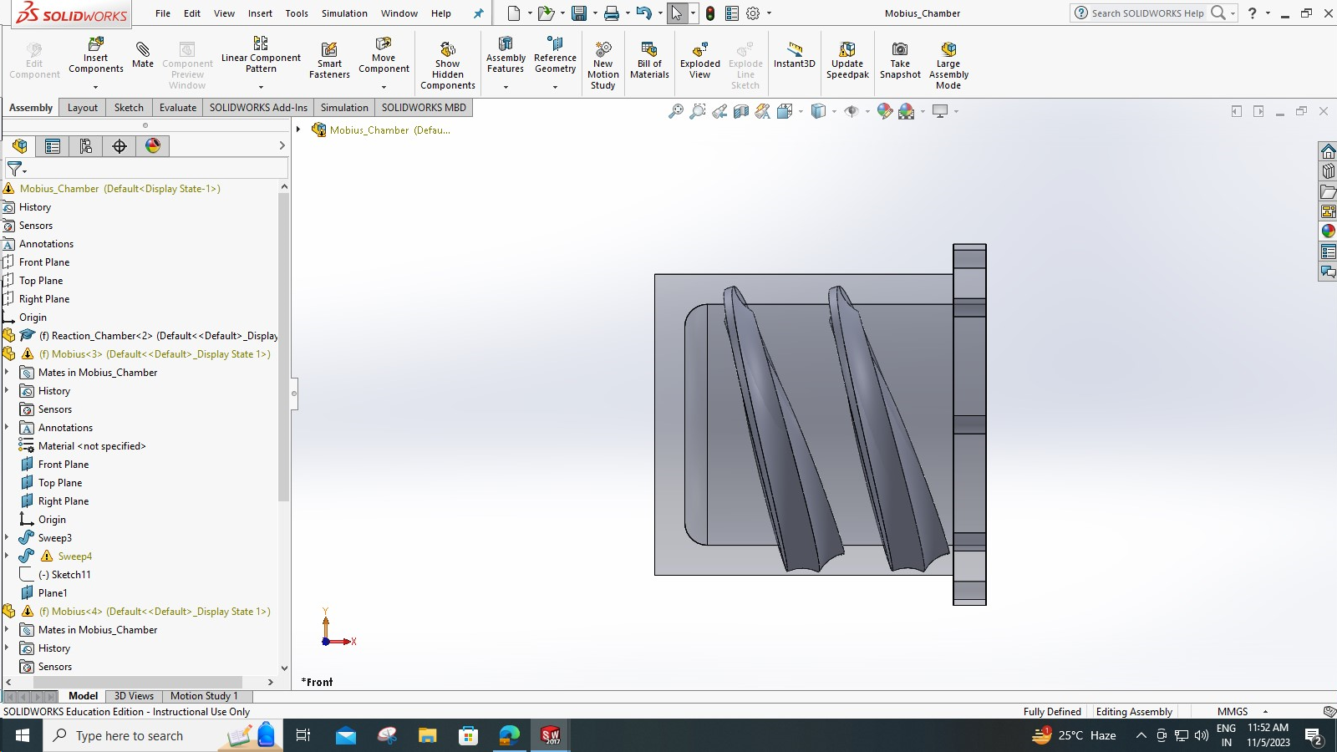
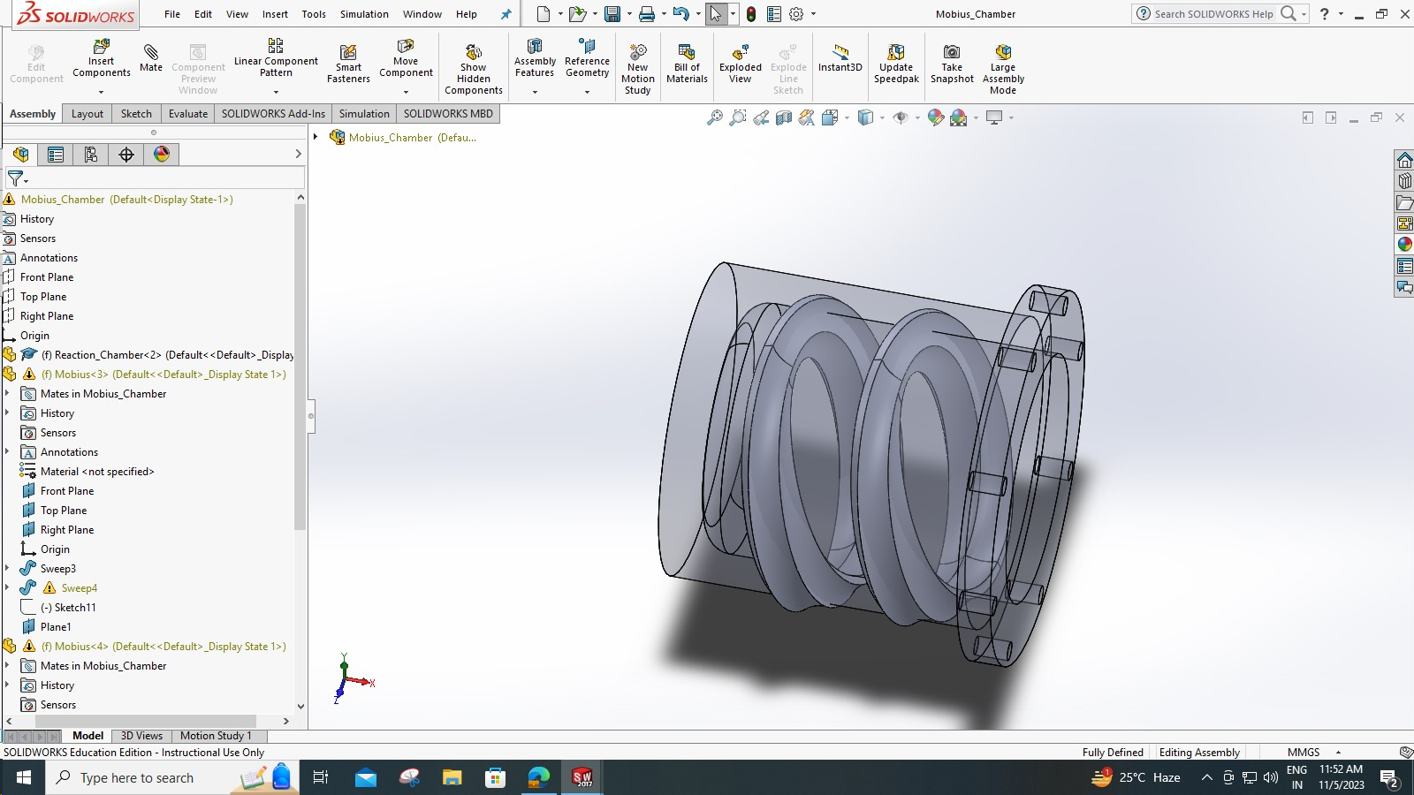
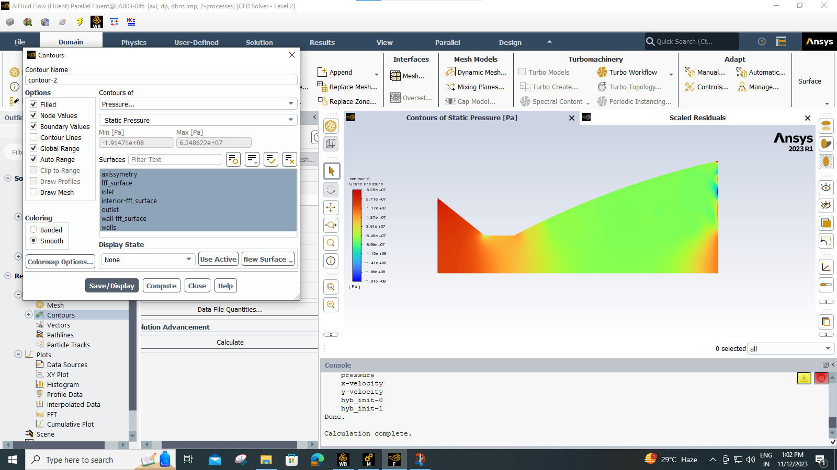
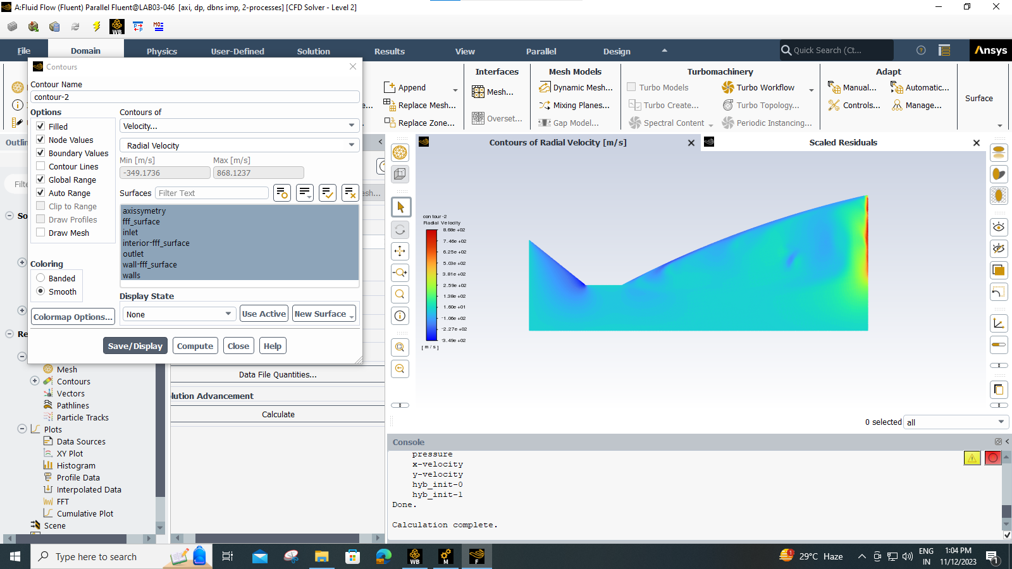
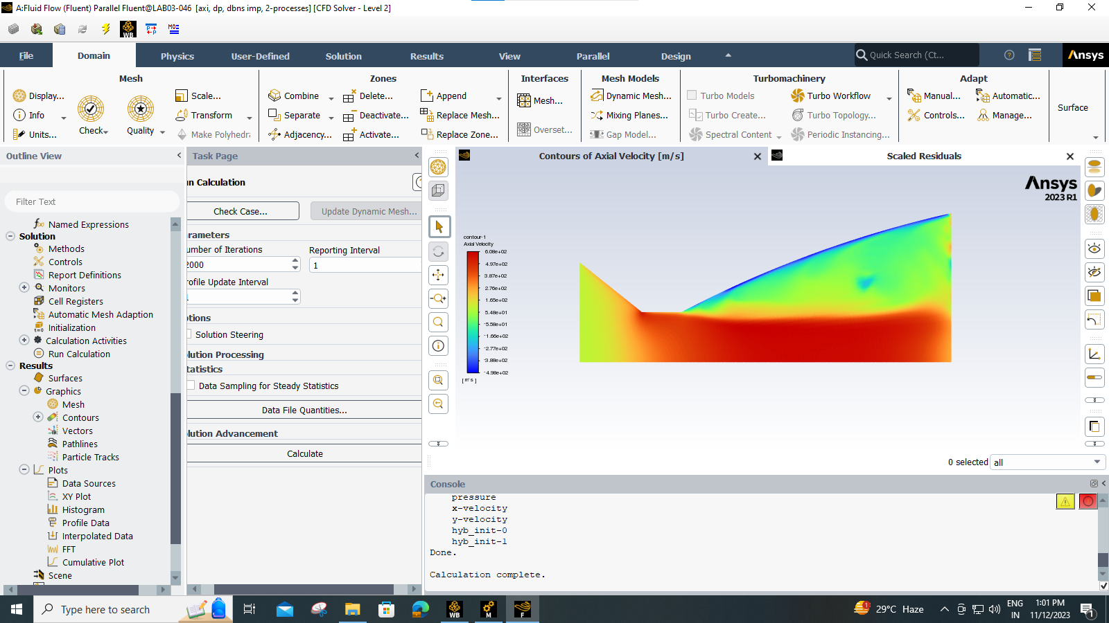
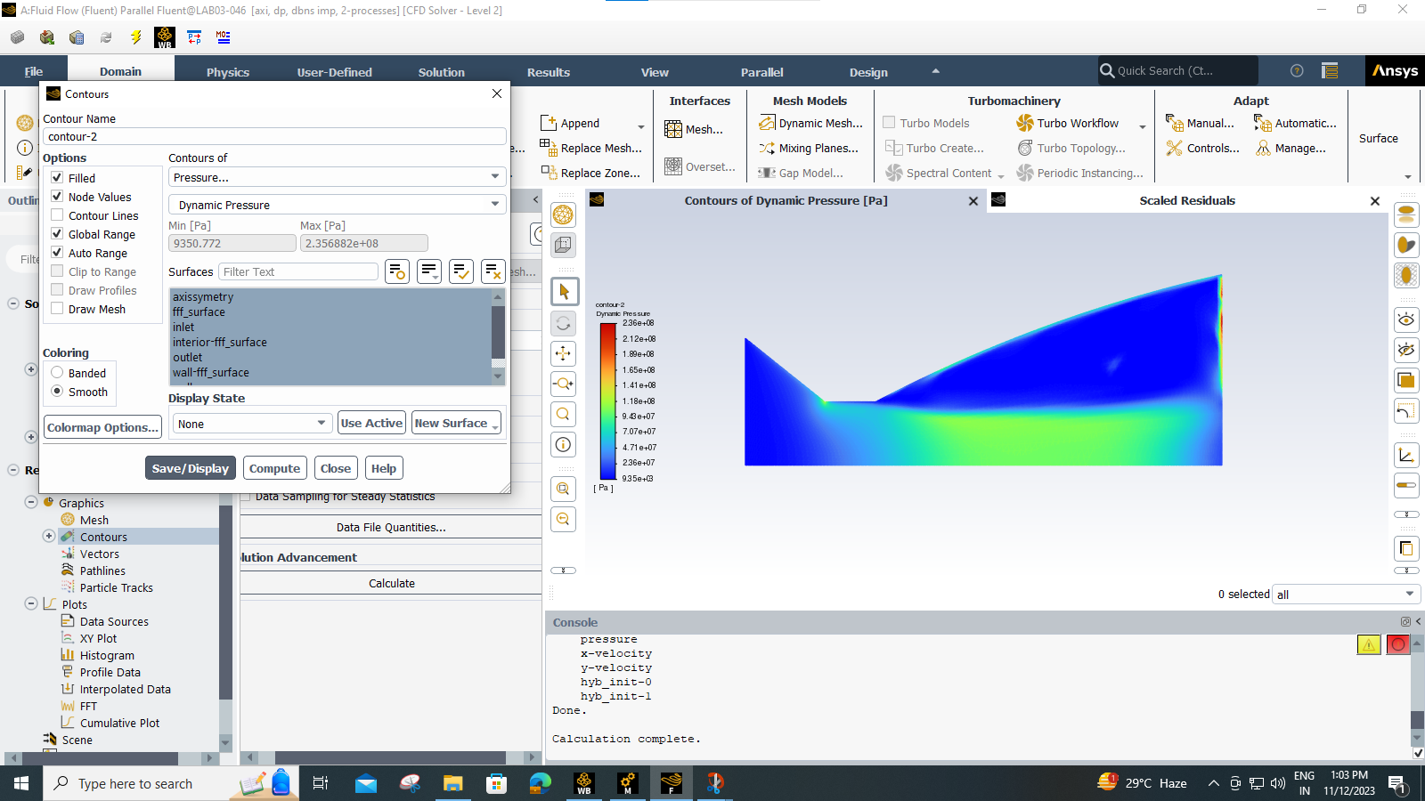
Summary

Slide 5
Reaction Chamber & Contours
Static Pressure Contour
Dynamic Pressure Contour
Velocity Contour Along the axis
Velocity Contour perpendicular to the axis

Slide 6
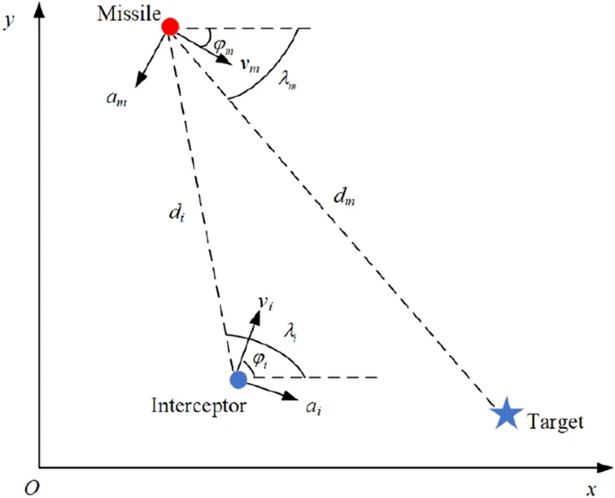
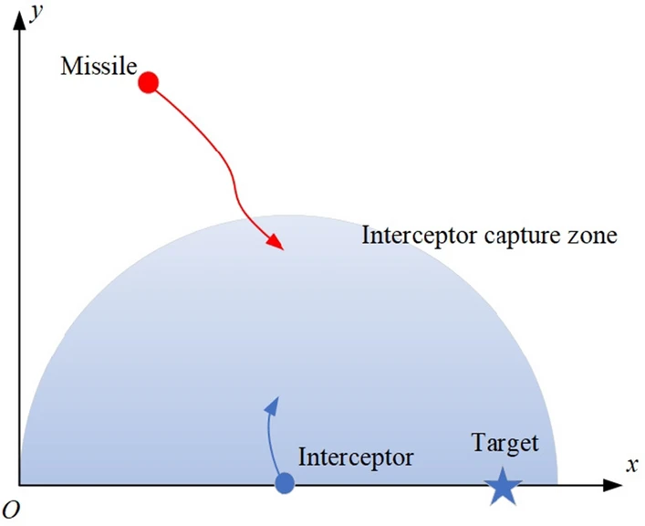
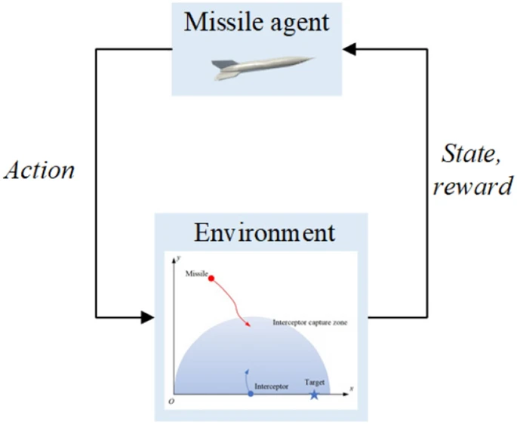
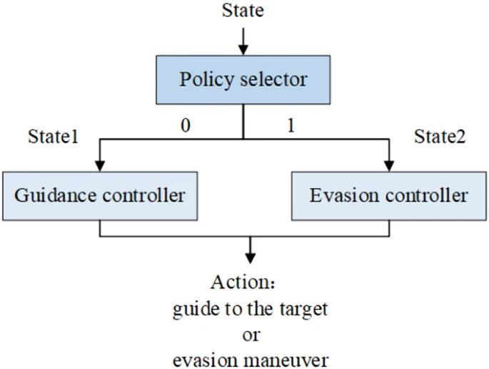
Manoeuvring

Slide 7
Further Progress

Slide 8
Aerodynamics of missile

Slide 9
Analysis
The problems that form the basis of the analysis:
1. The analysis process is only carried out on the speed and pressure experienced by the missile when it is launched.
2. Only variations in the value of α (with intervals of 5̊ from 0-15̊) are used to see the characteristics of missile aerodynamics.
The objective(s) of this research is:
1. To know the nature of the airflow around the missile when simulated.
2. To know the aerodynamic characteristics of missiles which simulated.

Slide 10
Specification of Missile
In general, the missile structure consists of :
1. The nose section, is the part of the missile that first hits the fluid while flying so that it experiences the greatest force compared to the other structures. The shape of this part affects the stability of the missile when sliding. The nose cone is made taper because the pointed shape has a maximum speed and can divide the airflow better.
2. The body, is a part of the missile that rubs against the fluid which then flows/passes fluid from the nose cone to the fin. In addition, this section is equipped with a chip that functions as a control system; and a place to put warheads.
3. Fin, is a fin that functions as a guide to the flow of air from the tip of the missile to its rear and also serves to make the missile movement more stable. The theory used for this wing study is linearization theory or Ackeret theory, which assumes that the airfoil used is thin; The type of flow used is two-dimensional flow. The selection of the wing/fin plan-form / shape must consider the aerodynamics, distance and expected manoeuvrability, suitability of the operating system, mass and configuration of the structure, and production costs.

Slide 11
Aerodynamics Of The Missile
The making of fluid flow simulations that pass the surface of the missile using CFD software was conducted to determine the aerodynamic characteristics of the missiles described in the form of simulations. The process of research consists of the initial study phase and the CFD simulation phase. The output and parameters of this research that are to be seen are pressure contours, velocity contours, lift and drag, which in each parameter is carried out by α of 0˚, 5˚, 10˚, and 15˚. The nature of the air flow around the missile when simulated has different characteristics of velocity and pressure in each variation α given. The change in α is directly proportional to the value of pressure. The speed value changes relative to each change α

Slide 12
Aerodynamics Of The Missile
To launch a missile, it should be noted about its aerodynamic characteristics such as lift, drag, and moment to facilitate the movement and control of the missile. The aerodynamic characteristics need to be considered because they greatly affect the altitude and distance that can be reached by the missile. In addition, note also the Mach value possessed by the missile when fired with each different speed. The most crucial thing about a missile is its flying/cruising height, where the height must be as low as possible to avoid detection from the radar, but also in its low altitude the missile must not lose the lift. In simulations, missile aerodynamic characteristics can be obtained through coefficients (CL and CD)

Slide 13
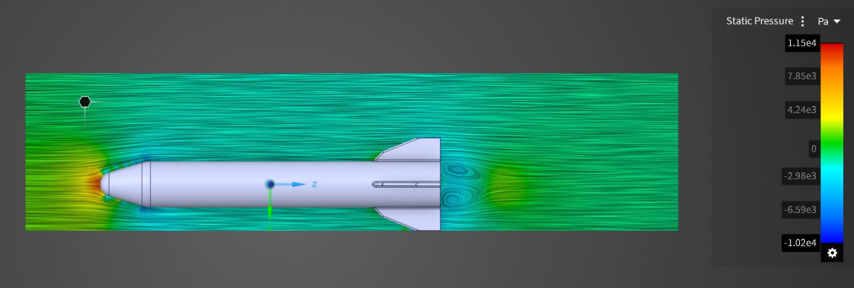
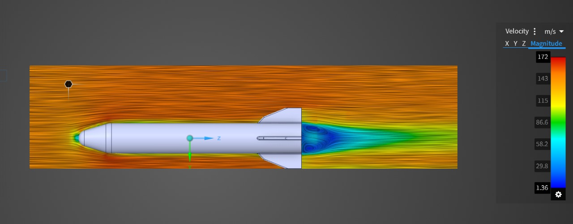
Static Pressure
Velocity

Slide 14
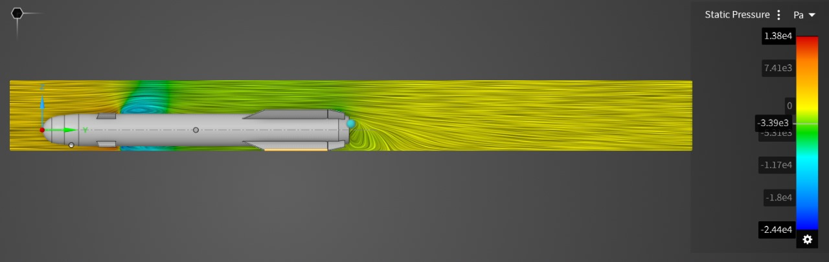
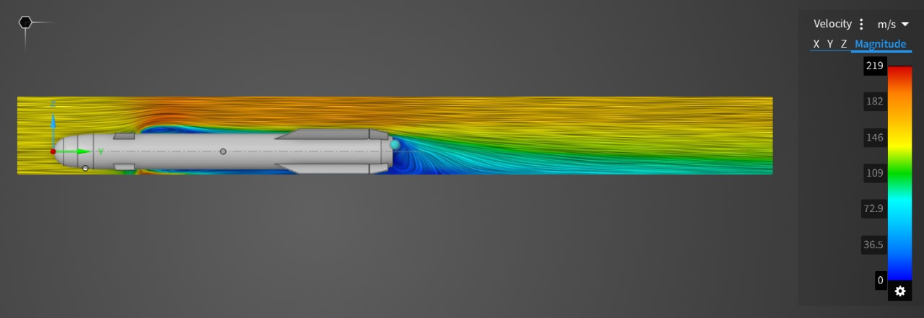
Static Pressure
Velocity

Slide 15
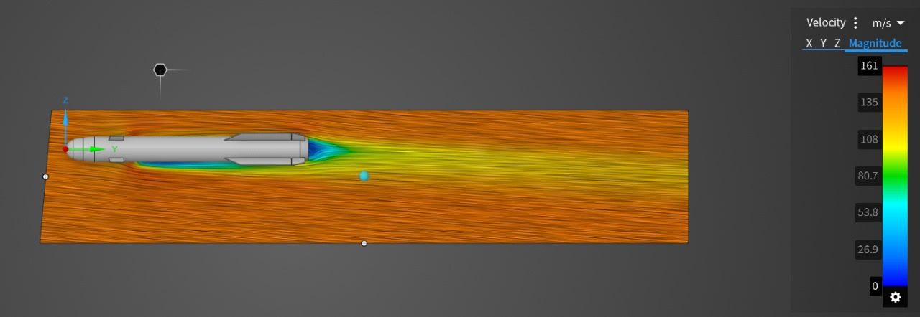
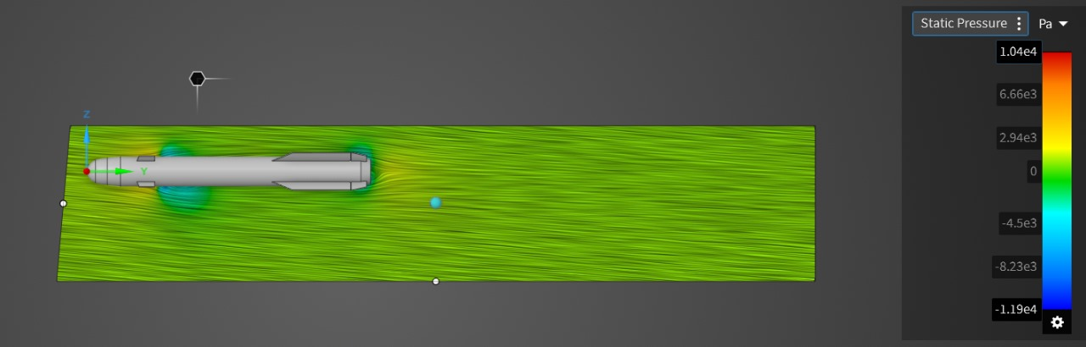
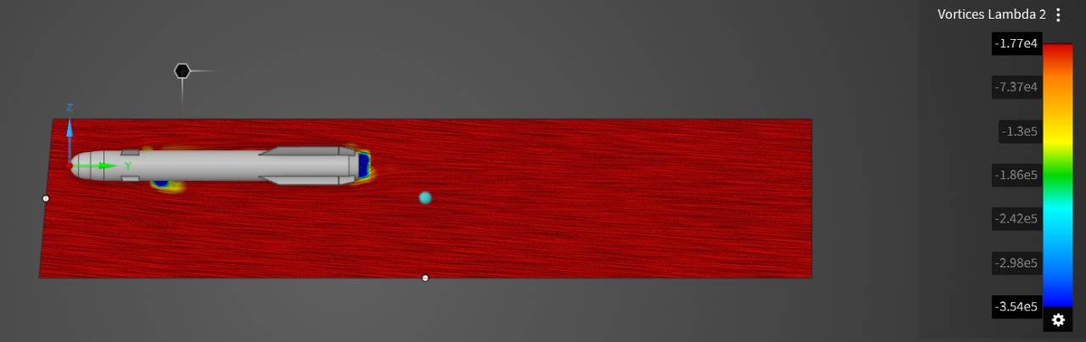
Velocity at 5 degree angle
Static Pressure at 5 degree angle
Vorticity at 5 degree angle

Slide 16
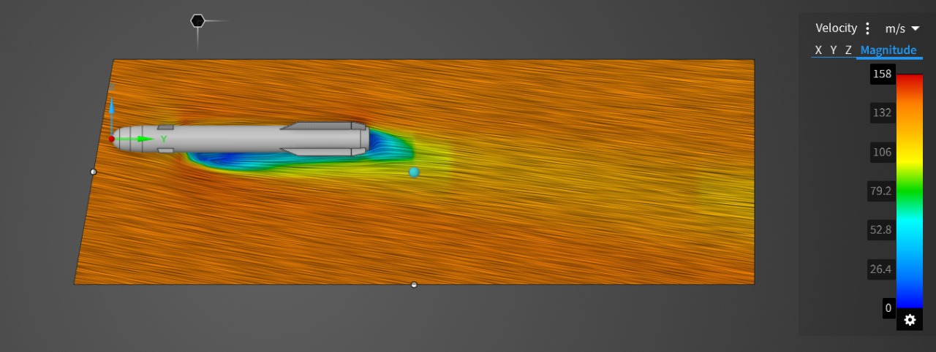
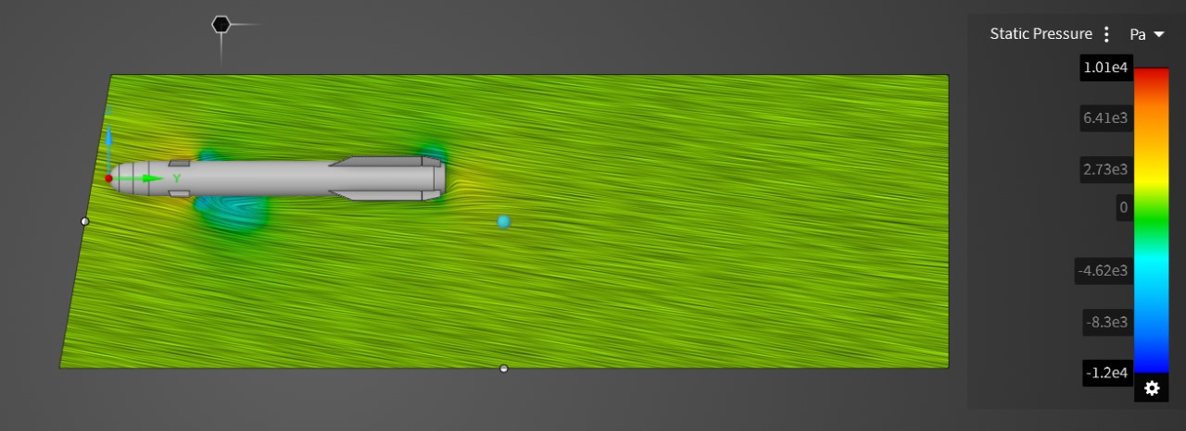
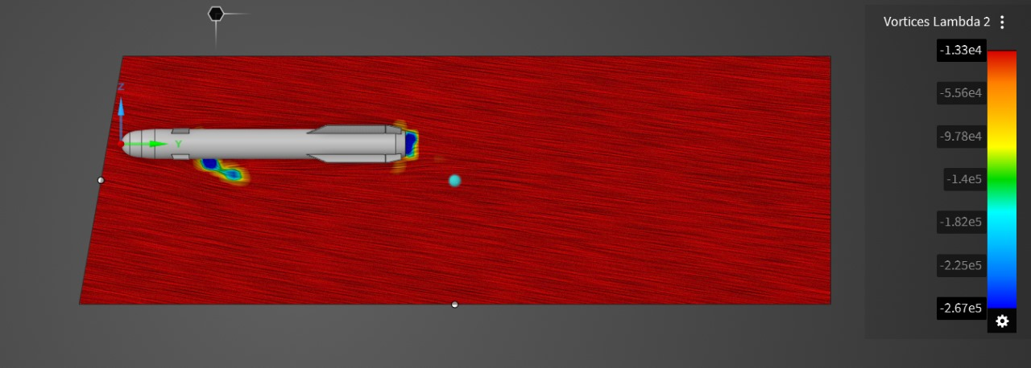
Velocity at 10 degree angle
Static Pressure at 10 degree angle
Vorticity at 10 degree angle

Slide 17
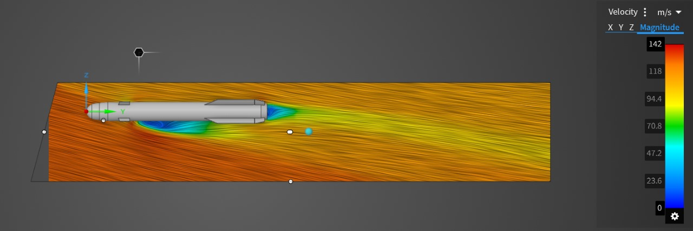
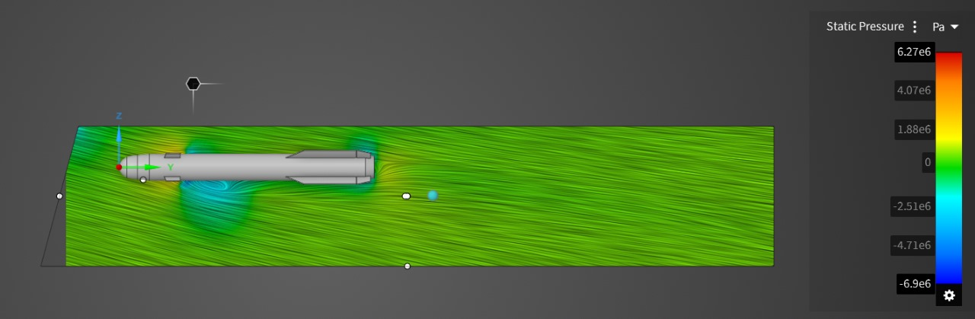
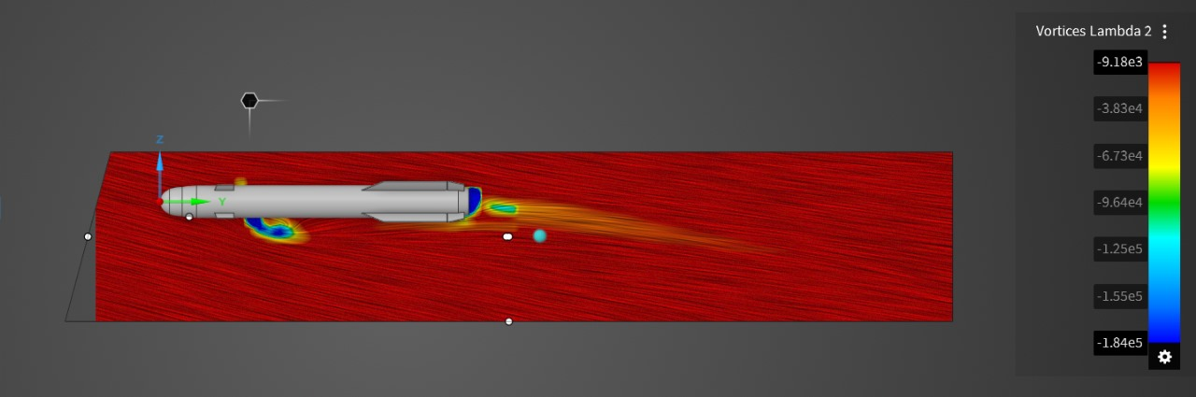
Velocity at 15 degree angle
Static Pressure at 15 degree angle
Vorticity at 15 degree angle

Slide 18
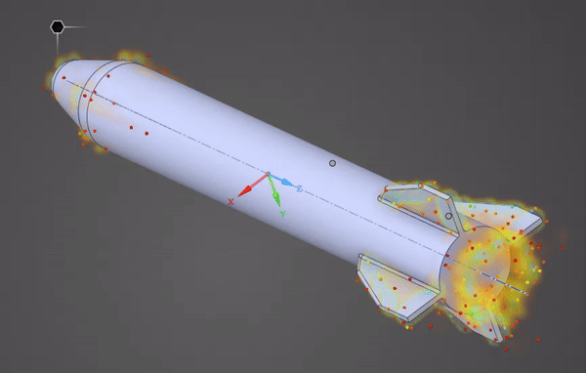
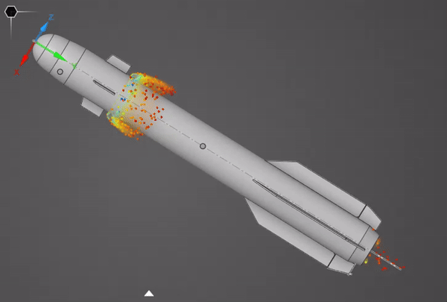

Slide 19
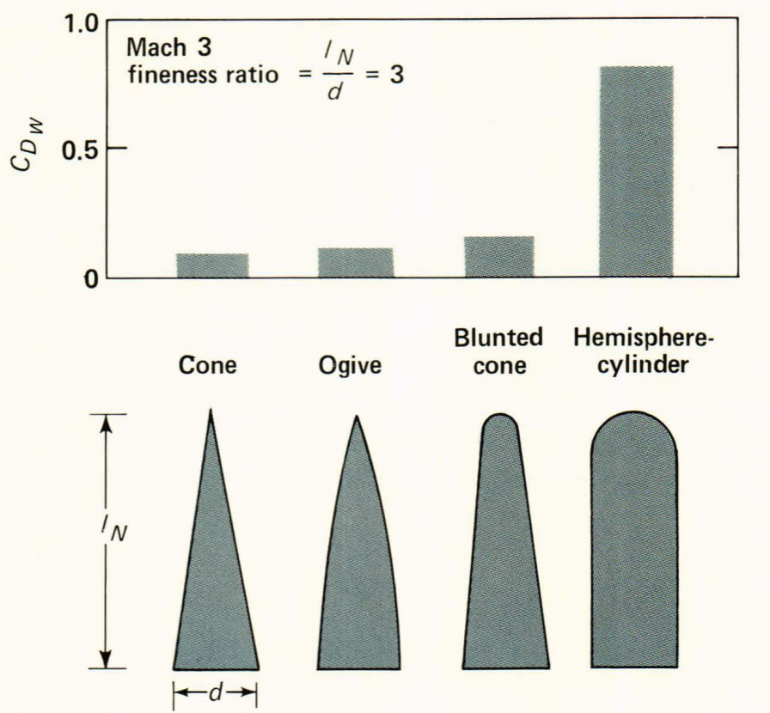
The choice of guidance system will affect the demands on missile maneuverability and response, which, in turn, may affect the choice of lifting and control surfaces. Furthermore, the design of domes to protect guidance sensors usually calls for compromises. For example, a hemispherical dome is usually considered the optimum choice for the sensors, but it has high drag. A dome with a high fineness ratio (i. e., length/ diameter ratio) has low drag but tends to degrade the reception of signals by the seeker.
The effect of sensor dome bluntness on the wave drag coefficient, C_{DW}

Slide 20
Inertial Navigation system

Slide 21
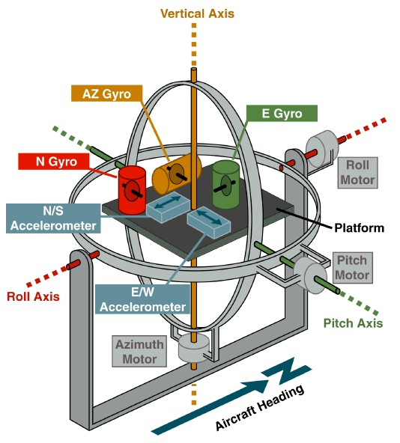
Introduction
An inertial navigation system (INS) is a sophisticated navigation tool used primarily in vehicles, aircraft, and ships to determine their position, orientation, and velocity without relying on external references such as landmarks, GPS signals, or radio beacons. Instead, it relies on internal sensors and computational algorithms to track its motion relative to an initial starting point.

Slide 22
Components of INS
Inertial Measurement Unit (IMU)
Gyroscope
Accelerometer
Computational Unit
Initial Alignment
Dead Reckoning
Error Correction
Integration with External Sensors

Slide 23
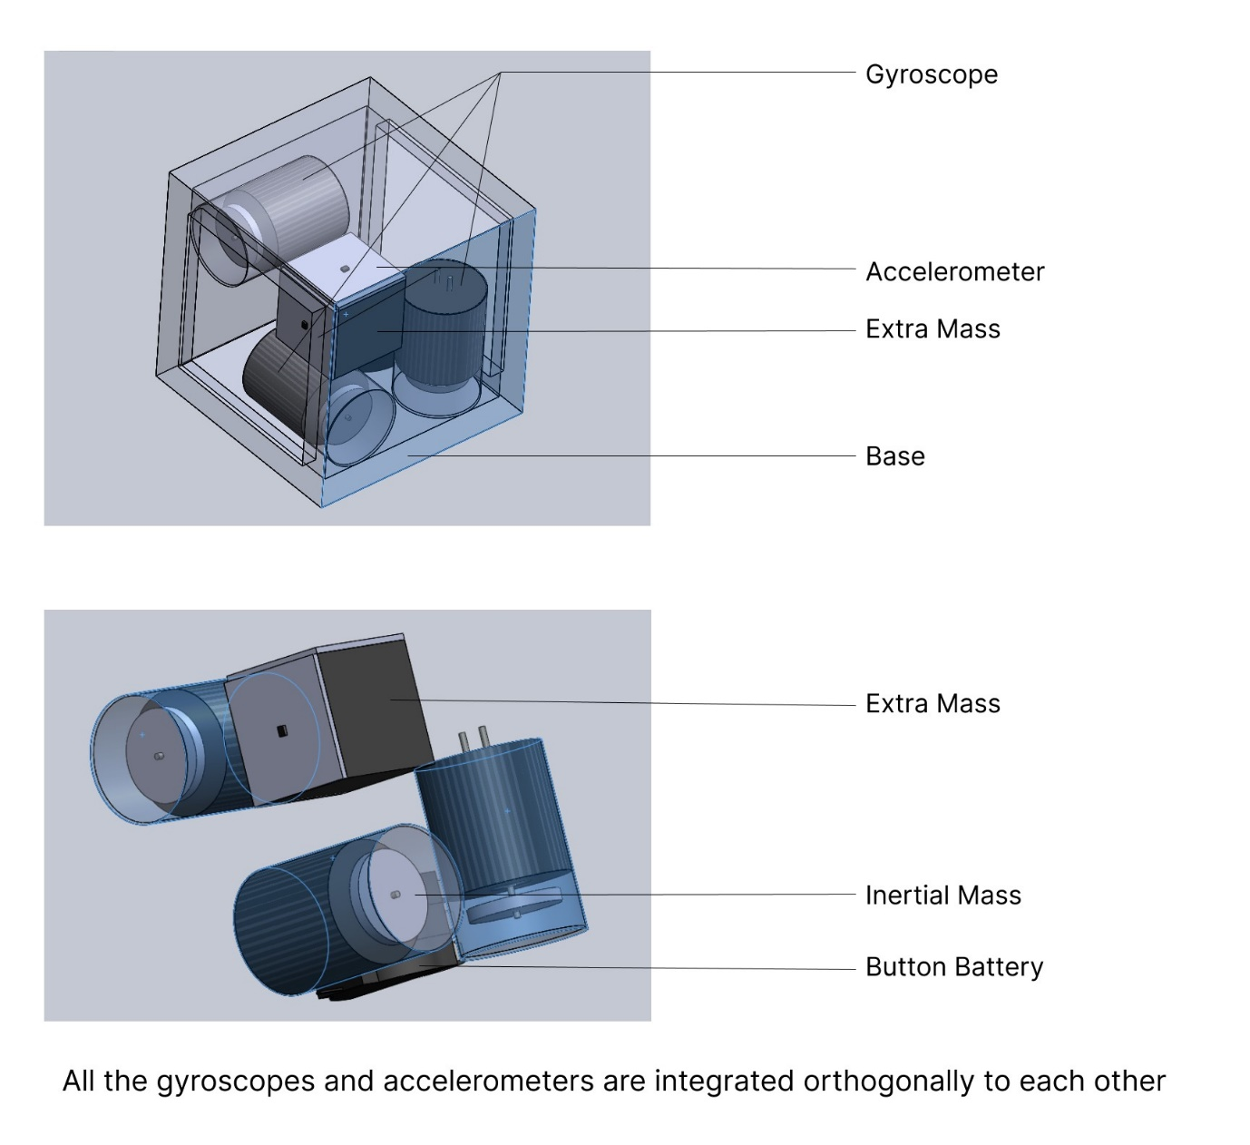
Reason for the disk-shaped mass of inertia in Gyroscope:
Disk has higher Inertia compared to Spere.
Space adjustments through smaller thicknesses.
Problems of having disk-shaped mass:
Higher value of radius increases the vibration.
Hole/ Drill at the centre can be different from the geometrical centre causing asymmetricity which increases the amplitude of vibration.
Surfaces should be polished.

Slide 24
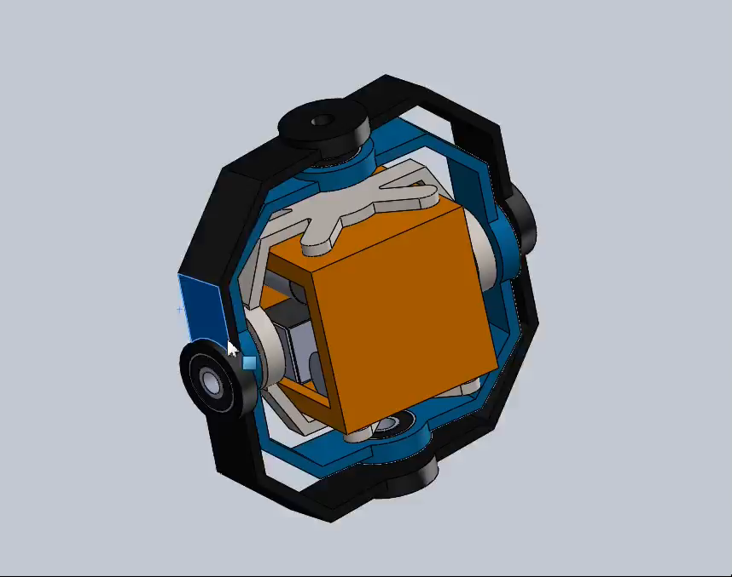

Slide 25
RL for Missile guidance system

Slide 26
Introduction
Reinforcement learning (RL) has recently emerged as a potent framework for training autonomous systems, including missile guidance systems, allowing them to autonomously learn optimal control strategies. In a simulated missile guidance scenario, the primary objective is to guide a missile from a launch point to a target point while maximizing proximity to the target and minimizing the risk of collision. Q-learning, a foundational RL algorithm, is particularly relevant for such autonomous systems, offering a systematic approach to learning optimal control policies by estimating expected future rewards associated with different actions in a given state.

Slide 27
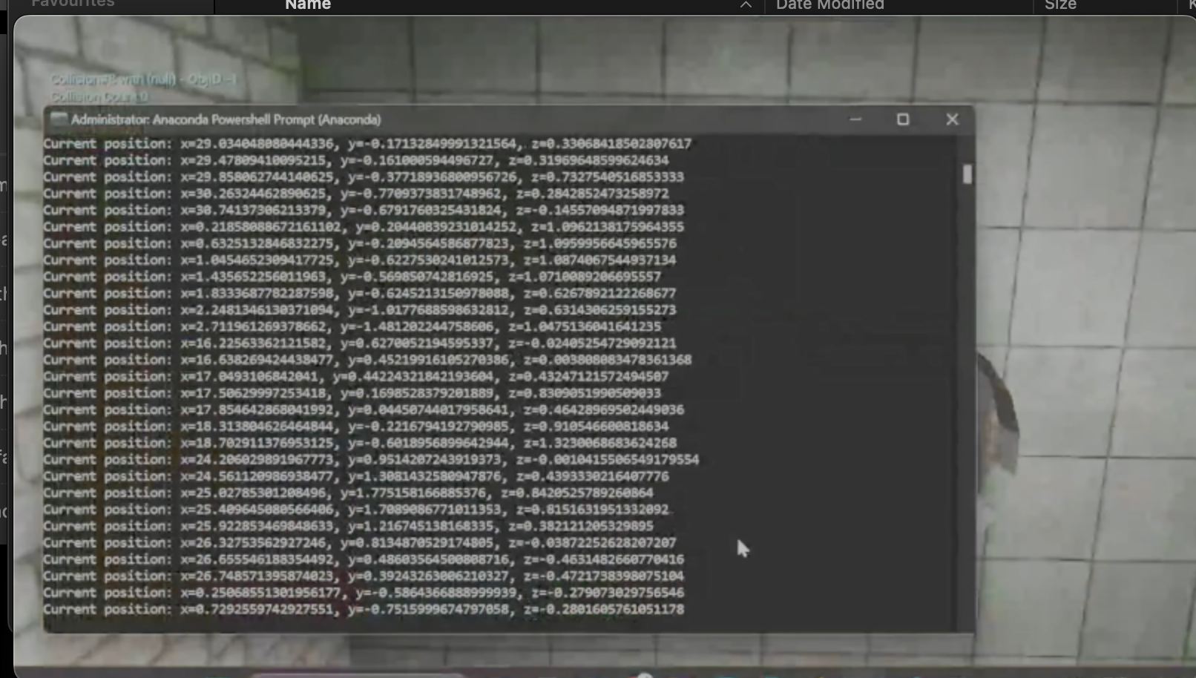
Simulation for Drone

Slide 28
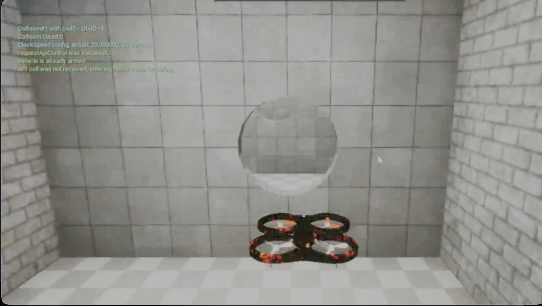
RL training for Drone

Slide 29
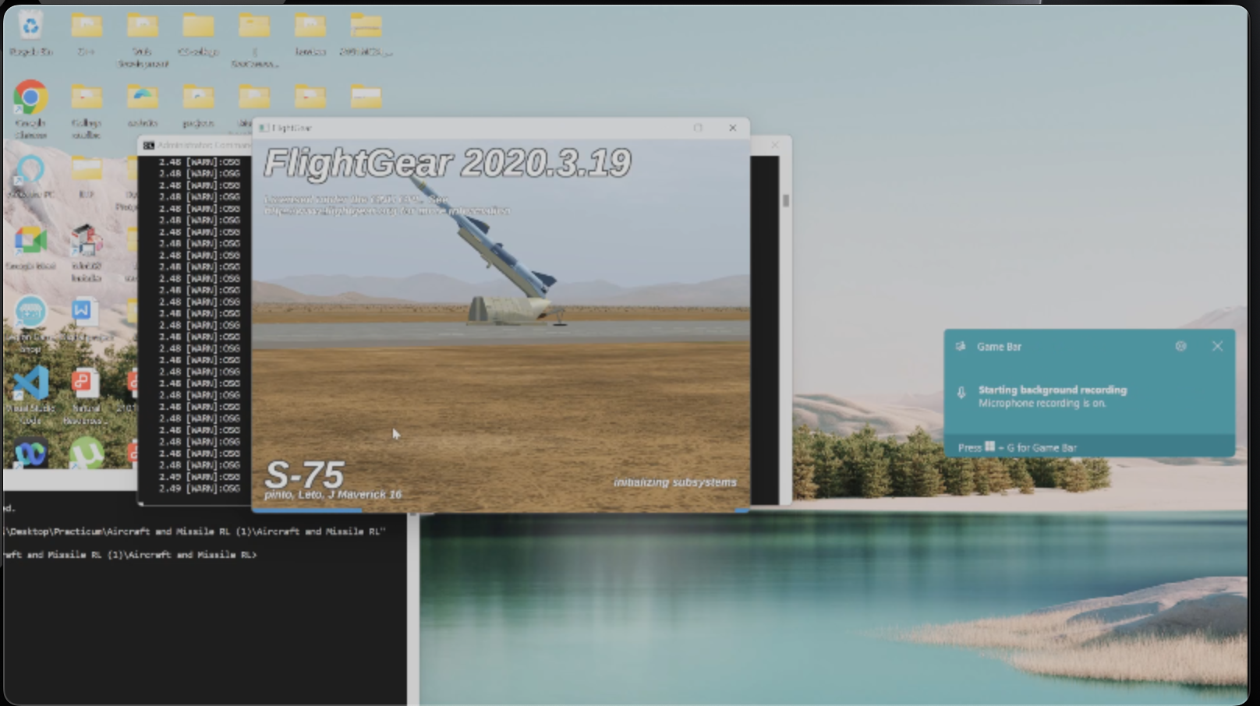
Missile - Environment

Slide 30
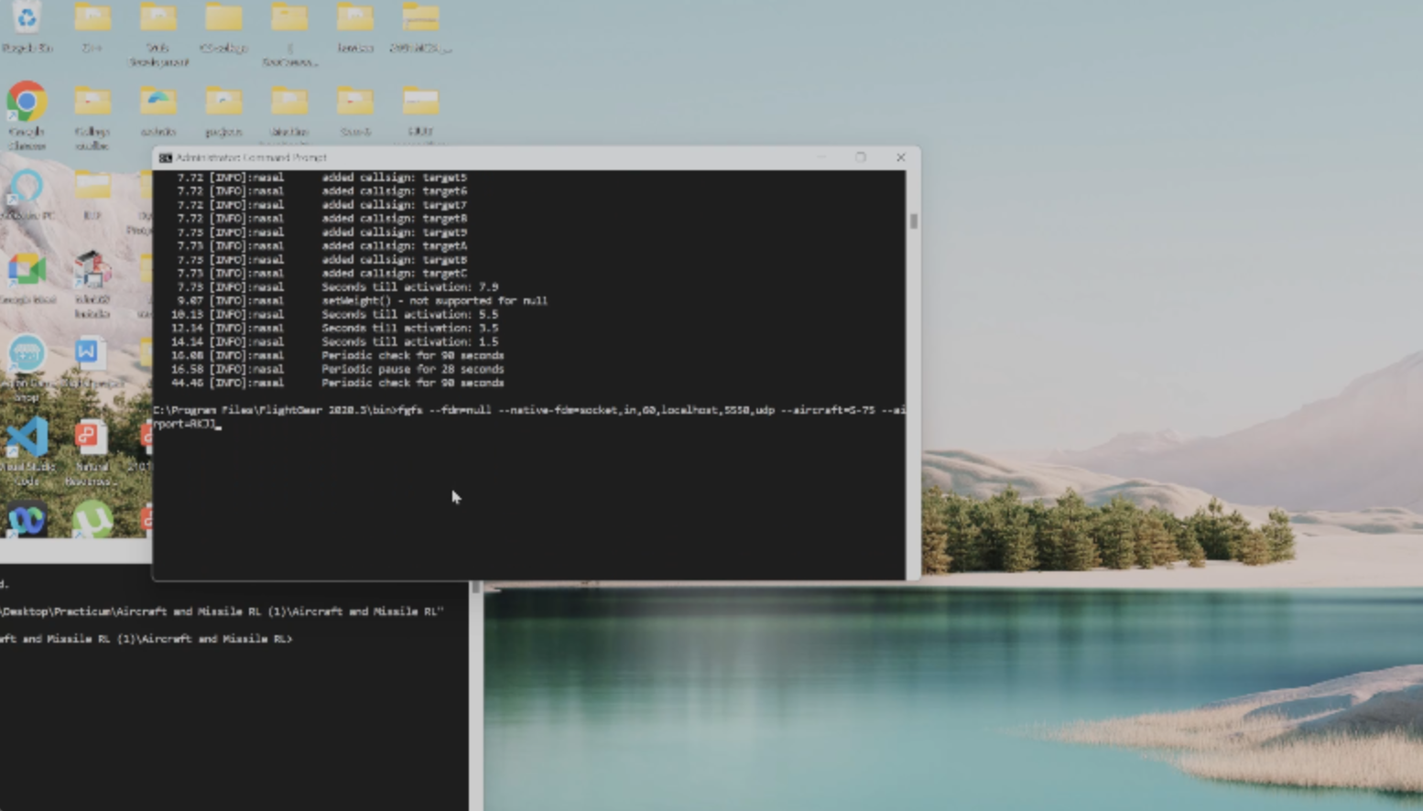
RL Simulation - Missile

Slide 31
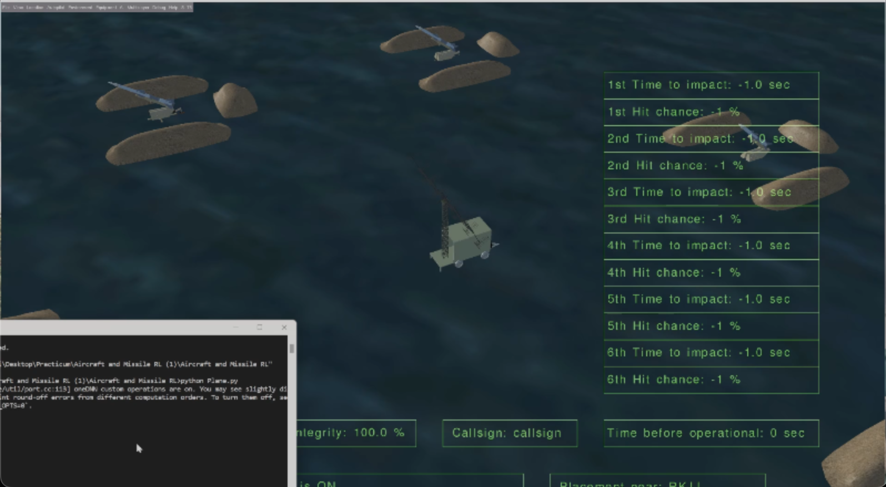
Model Training - Missile

Slide 32
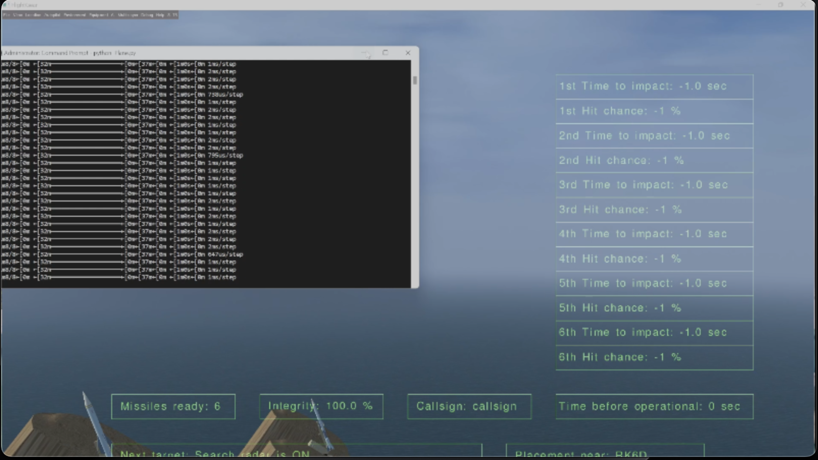
Model Training - Missile

Slide 33
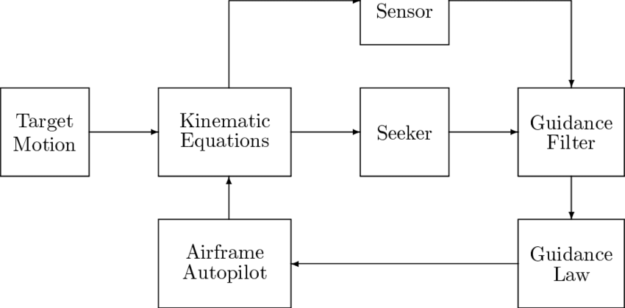
How does the Guidance system work

Slide 34
References
Measurement systems (Ernest O Doebelin | Dhanesh N Manik)
Global Navigation Satellite Systems, Inertial Navigation, and Integration (Mohinder S. Grewal, Angus P. Andrews, and Chris G. Bartone)
https://people.ece.cornell.edu/land/courses/eceprojectsland/STUDENTPROJ/2005to2006/me53/report.pdf

Slide 35
THANK YOU
Sasank Gupta (2101ME60)
Yashraj (2101ME84)
Vinay (2101ME79)
Nishant M (2101ME83)
Nishant Rao (2101ME45)

